Slide 1
Information Security
week 3

Slide 2
Learning Objectives
By the end of this lecture you should be able to:
1
Classify ciphers
2
Apply encryption formulas
Distinguish monoalphabetic, polygraphic, and polyalphabetic substitution ciphers and explain when each category applies.
Use the mathematical formulas for Caesar and Vigenère encryption and decryption, working correctly with modular arithmetic.
3
Construct worked examples
4
Identify weaknesses
Encrypt and decrypt messages using Caesar, Simple Substitution, Playfair, Vigenère, and Auto-key Vigenère — step by step.
Explain the primary cryptanalytic attack against each cipher — brute force, frequency analysis, digraph analysis, Kasiski examination.

Slide 3
Classical Ciphers
Caesar, Substitution, Playfair, Vigenère, and Auto-key Vigenère.
Teaching goal: Understand how early encryption methods hide plaintext and why they are no longer secure today.
Plaintext
Ciphertext
Encryption
Original readable message
e.g., HELLO
Encrypted hidden message
e.g., KHOOR
Plaintext → Ciphertext
Decryption
Key
Ciphertext → Plaintext
Secret value or word that controls encryption

Slide 4
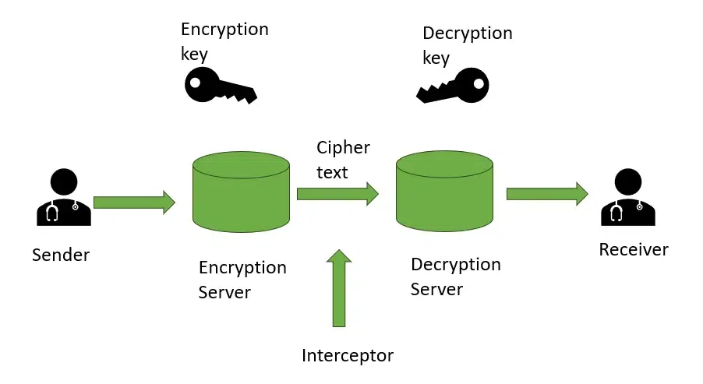

Slide 5
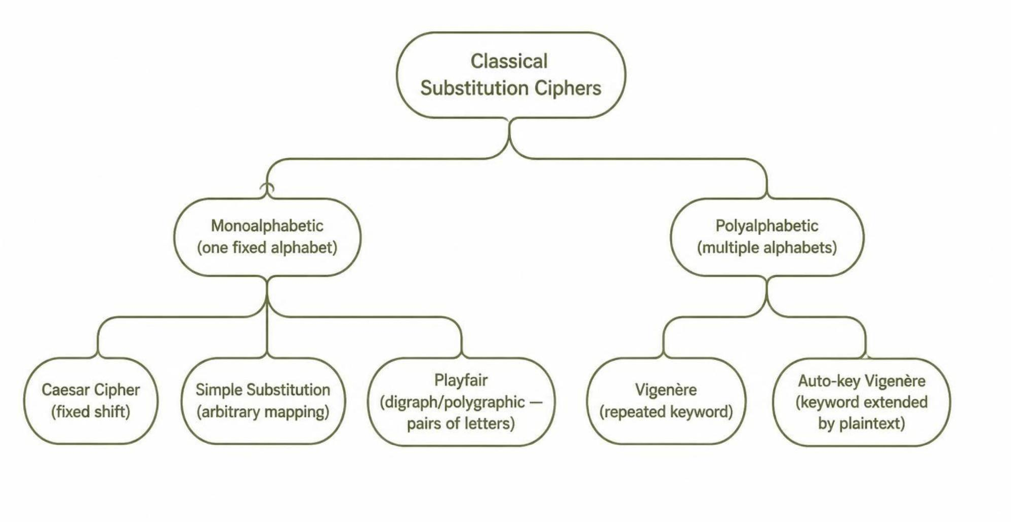
Classical Cipher Classification
Classical ciphers are organized by how many letters are substituted at once and whether the substitution alphabet changes across the message.

Slide 6

Caesar Cipher: Step-by-Step
The Caesar cipher shifts every letter by the same number of positions.
Example: Shift key = 3
Formula
Plain | A | B | C | D | E | ... | X | Y | Z
Cipher | D | E | F | G | H | ... | A | B | C
Where: A = 0, B = 1, … Z = 25
Worked Example: HELLO
Weakness: Only 25 useful shifts exist, so a brute-force attack is very easy.
Letter | Shift | Result
H | + 3 | K
E | + 3 | H
L | + 3 | O
L | + 3 | O
O | + 3 | R
Ciphertext: KHOOR

Slide 7


Simple Substitution Cipher
A simple substitution cipher replaces each letter using a fixed arbitrary mapping.
Example: Reverse Alphabet Substitution
Plain | A | B | C | D | E | ... | W | X | Y | Z
Cipher | Z | Y | X | W | V | ... | D | C | B | A
Encrypt: DATA
Caesar vs. Simple Substitution
Letter | Maps to
D | W
A | Z
T | G
A | Z
Caesar
Simple Substitution
Regular shift, e.g., +3. Only 25 possible keys.
Any fixed scrambled alphabet. Far more possible keys.
Remember: More possible keys does not guarantee real security if language patterns remain visible. Both ciphers leak letter-frequency patterns.
DATA → WZGZ

Slide 8

Playfair Cipher: Matrix and Text Preparation
Playfair encrypts two letters at a time. This makes it stronger than single-letter substitution because it hides simple letter frequencies better. It uses a 5×5 matrix. Since English has 26 letters but the matrix has 25 cells, I and J are usually combined.
Key: MONARCHY — The 5×5 Matrix
Preparing Plaintext — 4 Rules
M | O | N | A | R
C | H | Y | B | D
E | F | G | I/J | K
L | P | Q | S | T
U | V | W | X | Z
01
Remove spaces and punctuation
02
Split into pairs (digraphs)
03
If a pair has repeated letters, insert X
04
If one letter remains at the end, add X
Example: HELLO → HE LL O → HE LX LO

Slide 9

Playfair Encryption Rules and Example
Rule 1: Same Row
Rule 2: Same Column
Rule 3: Rectangle
Move each letter one step to the right. Wrap around if needed.
Move each letter one step downward. Wrap around if needed.
Each letter stays in its own row but takes the other letter's column.
Example: Pair HI
Weakness: Playfair can still be attacked using digraph frequency analysis, since common letter pairs in English (like TH, HE) may reveal patterns.
H is row 2, column 2.
I is row 3, column 4.
Rectangle rule applies: H → B and I → F.
HI → BF
Full HELLO Example
Prepared Pair | Rule Applied | Ciphertext
HE | Rectangle | CF
LX | Rectangle | SU
LO | Rectangle | PM
Ciphertext: CFSUPM

Slide 10
Examples for Playfair Cipher
Example 1:
Key = MONARCHY
Plaintext = INSTRUMENTS
Example 2: Repeated letters
Key = MONARCHY
Plaintext = BALLOON
Example 3:
Key = PLAYFIREXM
Plaintext = HIDE THE GOLD
Example 4: Decryption
Reverse the rules: 1-same row → letter to the left
2- same column → letter above
3-rectangle → same as encryption.
Key = MONARCHY
Ciphertext = GATLMZCLRQXA

Slide 11
Solution to the Examples:
1-Ciphertext: GATLMZCLRQXA
2-Ciphertext: IBSUPMNA
3-Ciphertext: BMODZBXDNAGE
4-Plaintext: INSTRUMENTSX
(drop the padding X → INSTRUMENTS)

Slide 12


Vigenère Cipher: Changing Shifts
Vigenère is polyalphabetic. It does not use one fixed shift like Caesar. Instead, it uses a keyword to decide a different shift for each letter.
Worked Example
Why It Is Better Than Caesar
Plaintext | A | T | T | A | C | K | A | T | D | A | W | N
Repeated Key | L | E | M | O | N | L | E | M | O | N | L | E
Ciphertext | L | X | F | O | P | V | E | F | R | N | H | R
Variable Shifts
Keyword: LEMON
The same plaintext letter can encrypt differently in different positions.
Each letter of the keyword provides a different shift value.
Weakness: The repeated keyword creates repeated patterns, which can be attacked using Kasiski examination and frequency analysis.
Formula
First Letter Worked Out
A = 0, L = 11
C = (0 + 11) mod 26 = 11 = L

Slide 13



Auto-key Vigenère Cipher
Auto-key Vigenère tries to reduce the repeated-key problem of regular Vigenère.
Regular Vigenère
Why It Helps
Keyword repeats again and again in a short cycle.
Plaintext-Autokey Version
No Short Cycle
Start with an initial key, then append plaintext letters to extend the key.
The key does not repeat in a simple short cycle, making pattern detection harder.
Worked Example
Plaintext | A | T | T | A | C | K | A | T | D | A | W | N
Extended Key | Q | U | E | E | N | L | Y | A | T | T | A | C
Ciphertext | Q | N | X | E | P | V | Y | T | W | T | W | P
Weakness: Still not secure by modern standards. It can be attacked using statistical methods or known-plaintext attacks.
Note: Some historical autokey variants extend the key using ciphertext instead of plaintext.
Initial key: QUEENLY — then plaintext letters A, T, T, A, C extend the key.

Slide 14
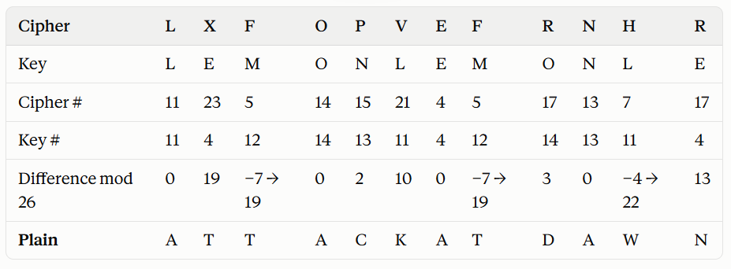
Decryption:
Key = LEMON
Ciphertext = LXFOPVEFRNHR
Plaintext: ATTACKATDAWN

Slide 15
Some more examples for Activity :
Example 2:
Key = KEY
Plaintext = HELLO
Example 3:
Key = SECRET
Plaintext = MEET AT NOON (spaces must be removed or ignored removed)

Slide 16


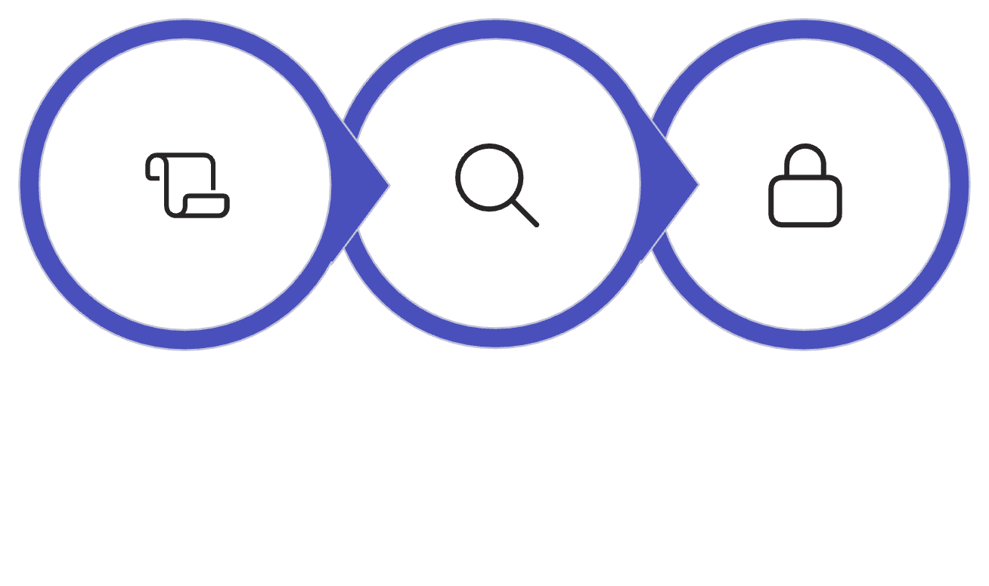
Comparison of Classical Ciphers
Cipher | Unit Encrypted | Key Method | Main Weakness
Caesar | One letter | Constant shift | Brute force (only 25 keys)
Simple Substitution | One letter | Fixed arbitrary mapping | Letter frequency analysis
Playfair | Two-letter pairs | 5×5 matrix | Digraph frequency analysis
Vigenère | One letter | Repeated keyword | Key periodicity (Kasiski)
Auto-key Vigenère | One letter | Initial key + plaintext | Statistical / known-plaintext attacks
Big idea: Classical ciphers are weak because language patterns leak through encryption. No matter how complex the key, if the structure of the language survives, the cipher can be broken.
Teaching takeaway: These ciphers are invaluable for learning the core concepts of confidentiality, keys, substitution, encryption, decryption, and cryptanalysis — the foundations of all modern security.
Classical
Polyalphabetic
Modern

Slide 17

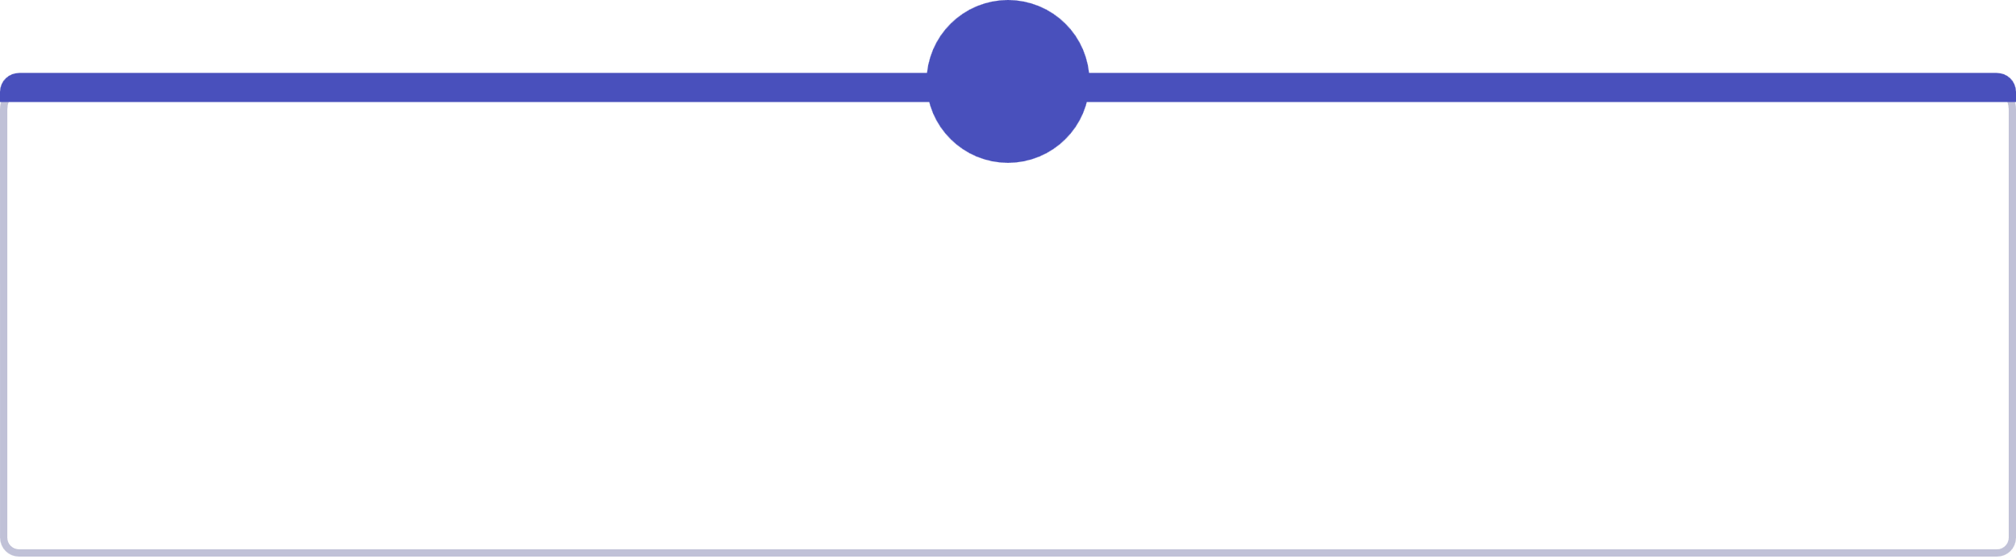
Classroom Practice + Answer Key
Practice Questions
Answer Key
1
2
# | Answer
1 | SECURITY → WIGYVMXC
2 | DATA → WZGZ
3 | 5×5 has 25 cells, so I/J are usually combined to fit 26 letters.
4 | HELLO + KEYKE → RIJVS
5 | Regular Vigenère repeats the keyword; Auto-key starts with an initial key and extends using plaintext.
Caesar Cipher
Substitution
Encrypt SECURITY using Caesar cipher with key 4.
Encrypt DATA using reverse alphabet substitution.
3
4
Playfair Matrix
Vigenère
Why does traditional Playfair use a 5×5 matrix?
Encrypt HELLO using Vigenère cipher with key KEY.
5
Auto-key vs. Vigenère
What is the main difference between regular Vigenère and Auto-key Vigenère?

